Slide 1
CHAPTER 10
Introduction to Simple Experiments

Slide 2
Chapter Outline
Experimental variables
Why experiments support causal claims
Independent-groups designs
Within-groups designs
Interrogating causal claims with the four validities

Slide 3
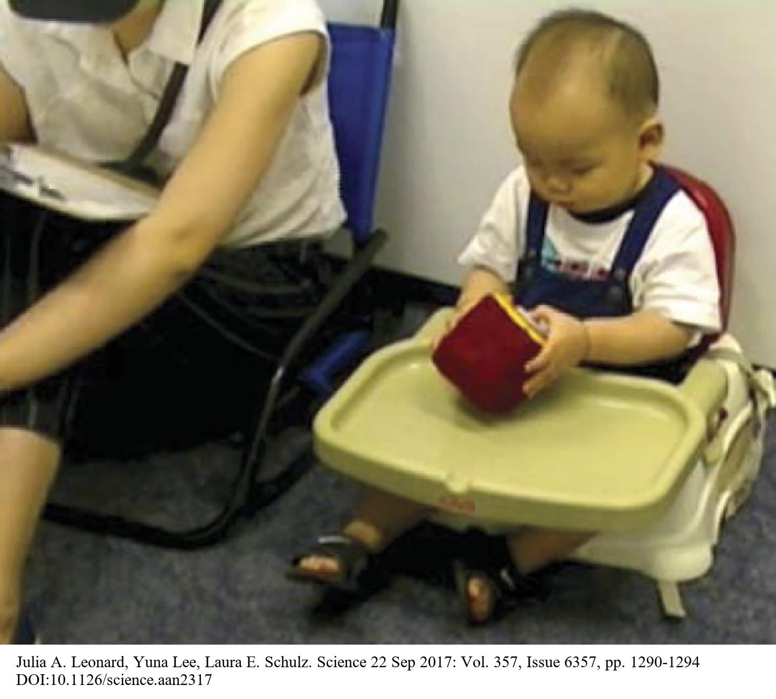
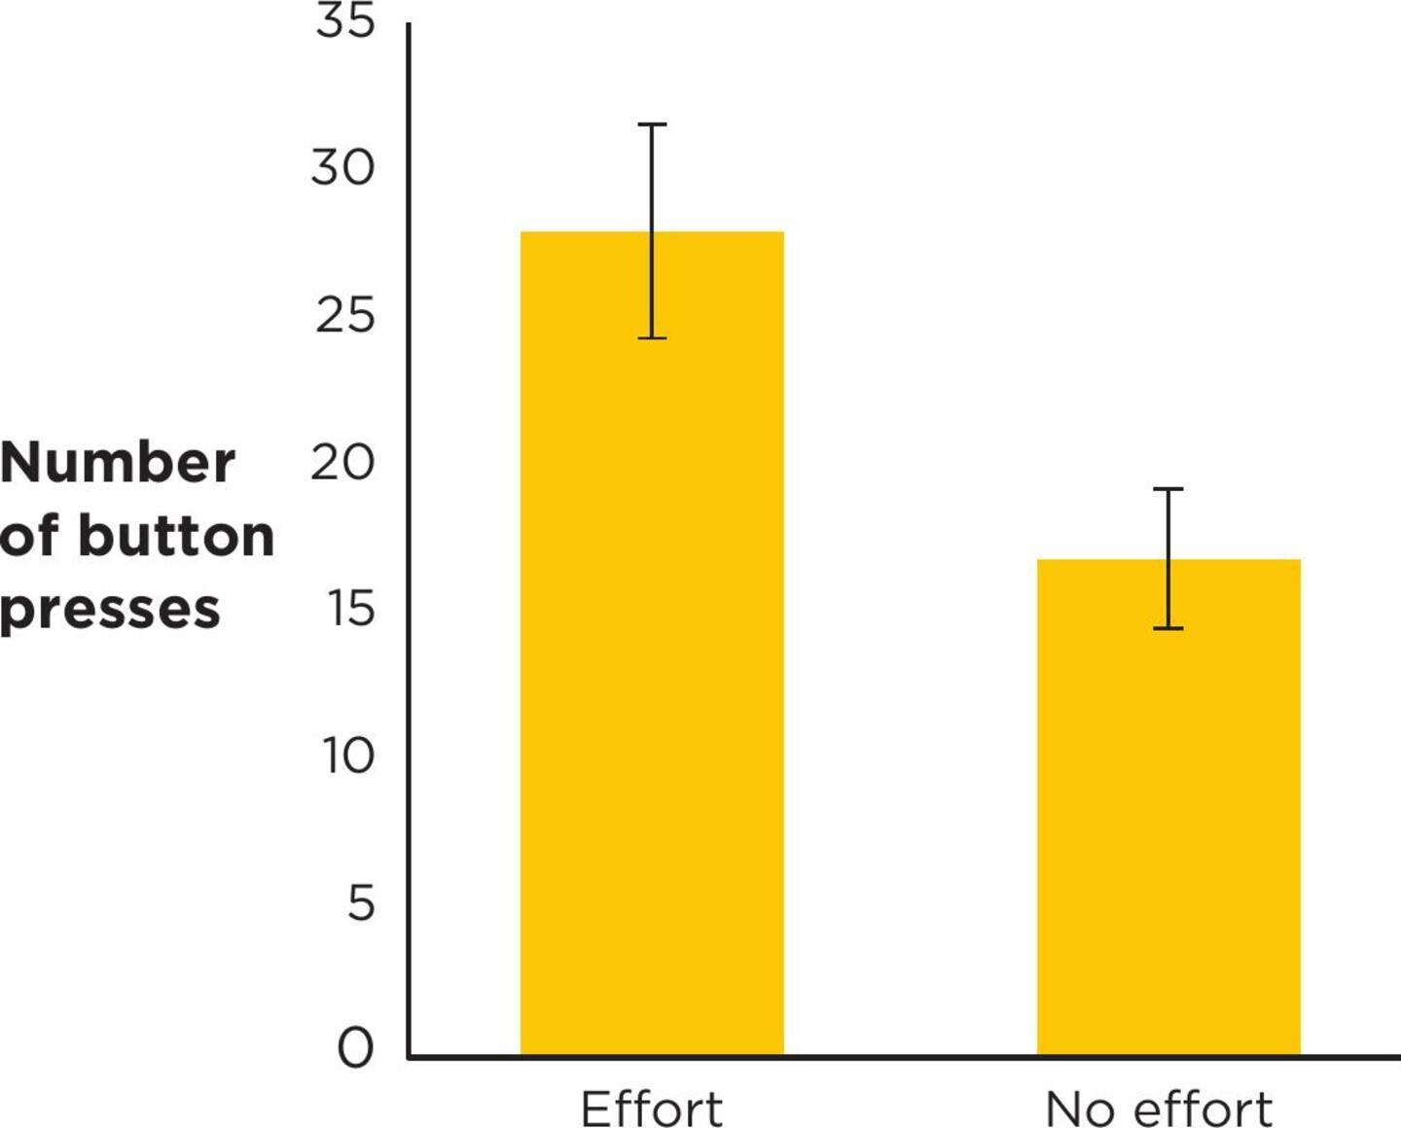
Example: Motivating Babies
Leonard et al. recruited more than 100 babies to investigate whether observing an adult putting effort into achieving goals influences infants to persist harder at a novel task.
Notes:
Figure 10.3 Measuring persistence.
A baby tries to get the toy to play music in the persistence study. The researchers measured how many times the baby pressed the large, inert button on the toy.
Julia A. Leonard, Yuna Lee, Laura E. Schulz. Science 22 Sep 2017: Vol. 357, Issue 6357, pp. 1290-1294 DOI:10.1126/science.aan2317
Figure 10.4 The results of Leonard et al.’s study on persistence in babies.
The error bars represent standard error of each mean. (Source: Adapted from Leonard et al., 2017.)
Example 2: Leonard et al. recruited more than 100 babies aged 13 to 18 months to participate, and randomly assigned them to either an ”effort” or a “no-effort” condition.
In the effort condition, the babies watched a model try to get a toy frog out of a plastic box. The model repeated “How do I get this out?” while trying several different ways, and after she succeeded, she said, “I got it out!” Then the model tried several times to unhook a toy from a carabiner, saying “How do I get this off?” and “Yay!” after she succeeded.
In the no-effort condition, the model worked with the same toys for the same amount of time, but simply took the toy frog out of the box three times in a row and easily took the toy off the carabiner three times.
After modeling each condition, the model handed the baby a toy that played music, with a large white button that looked like it should start the music but actually did nothing. The researchers recorded how long the babies spent playing with the toy, and how many times they tried pressing the inert button. As Figure 10.4 depicts, the babies in the effort condition pressed the inert button about 11 times more than the babies in the no-effort condition. The researchers made a causal claim that “seeing just two examples of an adult working hard to achieve her goals can lead infants to work harder at a novel task relative to infants who see an adult succeed effortlessly” (Leonard et al. 2017). Do you think the results of this study support the researchers’ causal claim?
Instructors: See the IIG for information on a re-creation of this study in Netflix’s Babies series.

Slide 4
Experimental Variables
Experiment: at least one variable was manipulated and at least one variable was measured by the researcher.
Manipulated variable: the researcher assigns participants to a particular level of the variable; example: poster condition (levels: norms and flu shot).
Measured variable: research records what happens in terms of behavior of attitudes based on self-report, behavioral observations, or physiological measures; example: number of anagrams solved correctly.
Notes:
This slide presents section headings.
Experiment: at least one variable was manipulated and at least one variable was measured by the researcher.
Manipulated variable: the researcher assigns participants to a particular level of the variable; example: poster condition (levels: norms and flu shot).
Measured variable: research records what happens in terms of behavior of attitudes based on self-report, behavioral observations, or physiological measures; example: number of anagrams solved correctly.

Slide 5
Independent and Dependent Variables
Independent variable (IV): manipulated
  Conditions: levels of an independent variable
Dependent variable (DV): measured, outcome variable
Notes:
Independent variable (IV): an independent variable is manipulated by the researcher; example: adult model’s effort behavior was the IV in the motivating babies’ study.
IVs have levels, and the levels of an IV are called conditions. So if your IV was adult model’s effort behavior, the levels/conditions could be effort and no effort. It’s up to the researcher to select the conditions (levels).

Slide 6
Control Variables
Control variable: any variable that an experimenter holds constant
Notes:
The term control variable is actually a misnomer, because the word variable suggests change, yet a control variable is held constant; example: in the Murrar poster study, all participants viewed the posters in the same ways and in the same kinds of rooms.

Slide 7
Why Experiments Support Causal Claims
Experiments establish covariance.
Experiments establish temporal precedence.
Well-designed experiments establish internal validity.
Notes:
This slide presents the section headings.
Covariance: Is the cause variable related to the effect variable?
Temporal precedence: Does the cause variable come before the effect variable?
Internal validity: Are there alternative explanations for the results?

Slide 8
Experiments Establish Covariance
Independent variables answer the question, “Compared to what?”
  Comparison group (comparison condition)
Covariance: it is also about the results
Control groups, treatment groups, and comparison groups
  Control group (no treatment condition)
  Treatment group(s) (one or more treatment conditions)
  Placebo group (placebo control group)
Notes:
Both the baby study and the notetaking study show covariance between the IV and DV. Covariance is indicated by a difference in group means. In the pasta study, participants in the large bowl condition ate more calories than those in the medium bowl condition.
Independent variables answer the question, “Compared to what?” You might recall that our personal experiences don’t have the benefit of a comparison group (comparison condition). For example, let’s say you think you always persist at building IKEA furniture at home, but you’re not sure if it’s because you watched your parents try things over and over or you don’t have anything to compare it to. If IVs don’t vary (i.e., there’s not a mean difference between groups), then covariance has not been established.
Covariance: It’s also about the outcome. Your outcome variable (DV) is important too. If the number of button presses was the same in both groups of babies, then there is no covariance and watching models interact with toys in different ways does not relate to the number of times the baby presses the button.
Control groups, treatment groups, and comparison groups:
Control group: the neutral or no treatment level of the IV; not all experiments have, or need, a control group.
Treatment group(s): the nonneutral level or levels of the IV
Placebo group: the control group that is exposed to an inert treatment

Slide 9
Experiments Establish Temporal Precedence
The cause variable precedes the effect variable.
Notes:
Example: In the baby study, the experimenters manipulated the IV (modeled activity) first and measured the DV second to ensure that the causal variable preceded the effect variable in time.

Slide 10
Well-Designed Experiments Establish Internal Validity (1 of 2)
Important to interrogate internal validity when making causal claims
Must be able to rule out third-variable explanations
Increases confidence that change in IV produced observed change in DV
Notes:
Figure 10.5 A threat to internal validity.
If the waiting room with the control poster had been empty but the waiting room with norms poster had other students in it, that would have been an alternative explanation for the study’s results. (Study design and results are fabricated for illustration purposes.)
The section subheadings are on the left.
As you will recall, it is of primary importance to interrogate internal validity when making a causal claim. You need to be able to rule out third-variable explanations and feel confident that the IV caused the change in the DV (and not some other variable).
Confounds are these alternative explanations, and they can threaten internal validity. For example, in the poster study, it would be a confound if the room in which the flu shot poster was placed was structurally different from the room in which the norms poster was placed. In this case, your IV (type of poster) would be confounded (confused) with placement of the poster. So you couldn’t be sure if it the placement of the poster within different rooms affected the participants’ attention to the posters.

Slide 11
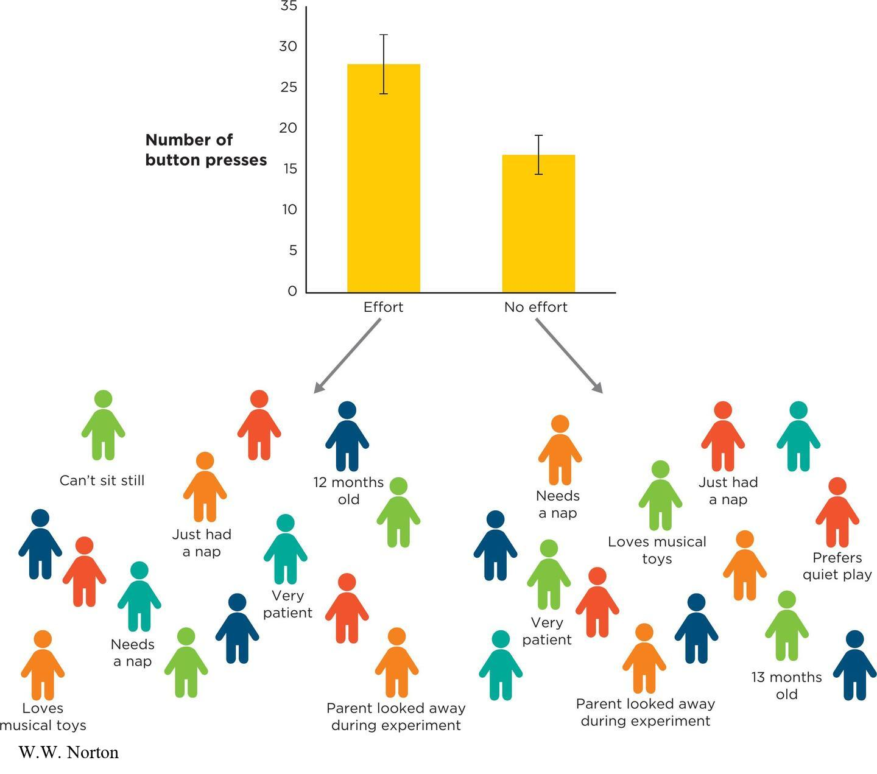
Well-Designed Experiments Establish Internal Validity (2 of 2)
What is a design confound?
Systematic variability is the problem
  Systematic variability
  Unsystematic variability
Notes:
Figure 10.6 Unsystematic variability is not the same as a confound.
Some babies like music more than others, some babies can sit still longer than others, and some babies just had a nap while others are tired. But individual differences don’t become a confound unless one type of baby ends up in one group systematically more than another group. If individual differences are distributed evenly in both groups, they are not a confound.
W.W. Norton
There is a design confound when a second variable varies systematically along with the IV and provides an alternative explanation for the results. Example: Consider the study on norms poster. If all of the students in the norms poster group had a more direct view of the poster than those in the flu poster, that would be a design confound. We would not know whether the difference in conceptual performance was caused by the content of the poster or its placement. If a design confound is present, it threatens internal validity, and we can’t support a causal claim in that case.
It is important to note that internal validity is only threatened if there is systematic variability with the IV. Example: If those participants in the large dish group had higher quality pasta than those in the medium dish group, then that’s systematic variability and a design confound.
Unsystematic variability is random or haphazard and affects both groups. It is not a confound. However, it can make it difficult to detect differences in your DV (this is experimental noise, which is covered in Chapter 11).

Slide 12
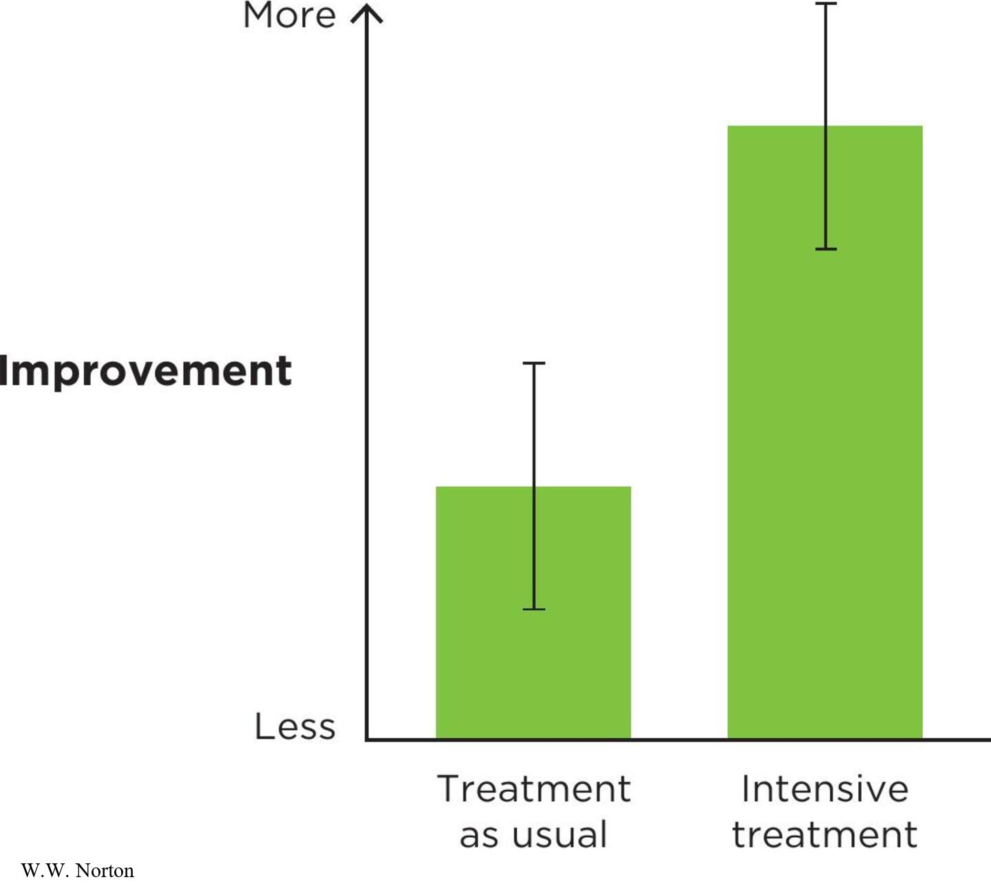
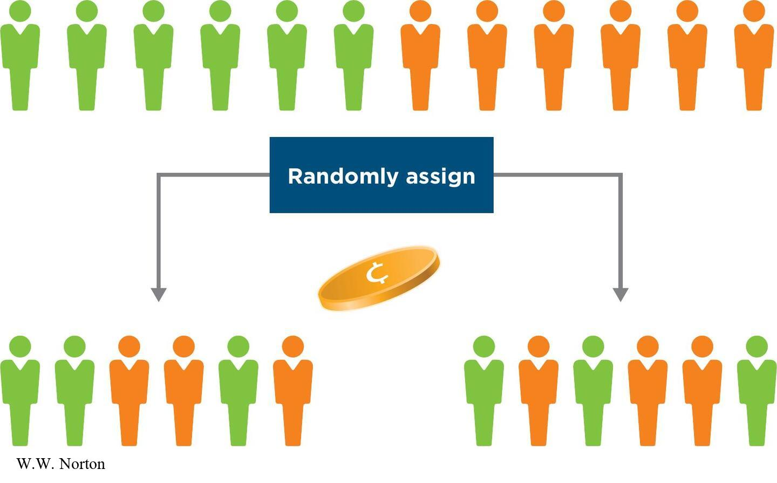
Selection Effects (1 of 2)
What is a selection effect?
Avoiding selection effects with random assignment
Notes:
Figure 10.8 Random assignment.
Random assignment ensures that every participant in an experiment has an equal chance to be in each group.
Figure 10.7 Selection effects.
In a study for treating autism, some parents insisted that their children be in the new intensive-treatment group rather than the treatment-as-usual group. Because they had this choice, it’s not possible to determine whether the improvement in the intensive-treatment group was caused by the treatment itself or by the fact that the more motivated parents chose it. (Data and error bars are fabricated for illustration purposes.)
W.W. Norton
A selection effect occurs in an experiment when the participants in one level of the IV are systematically different than the participants in the other level or levels of the IV.
For example, Lovaas (1987) conducted a study to test an intensive therapy for children with autism. Some children in the study received the new treatment and others continued their usual treatment. However, they were not randomly assigned to these groups because some families lived too far away for the intensive treatment, and other families requested the intensive treatment.
The researchers found that the autistic symptoms of children in the intensive treatment group showed more improvement than those in the usual treatment group. However, this study had a selection effect whereby the families in the intensive treatment group were probably systematically different than those in the usual treatment group. Therefore, it’s impossible to determine the reason for the improvement because of this selection effect.
Avoiding selection effects with random assignment: Random assignment is a way of assigning participants to levels of the IV such that each participant has an equal chance of being in each group. There should be no systematic difference between groups with random assignment. See the figure on the slide.

Slide 13
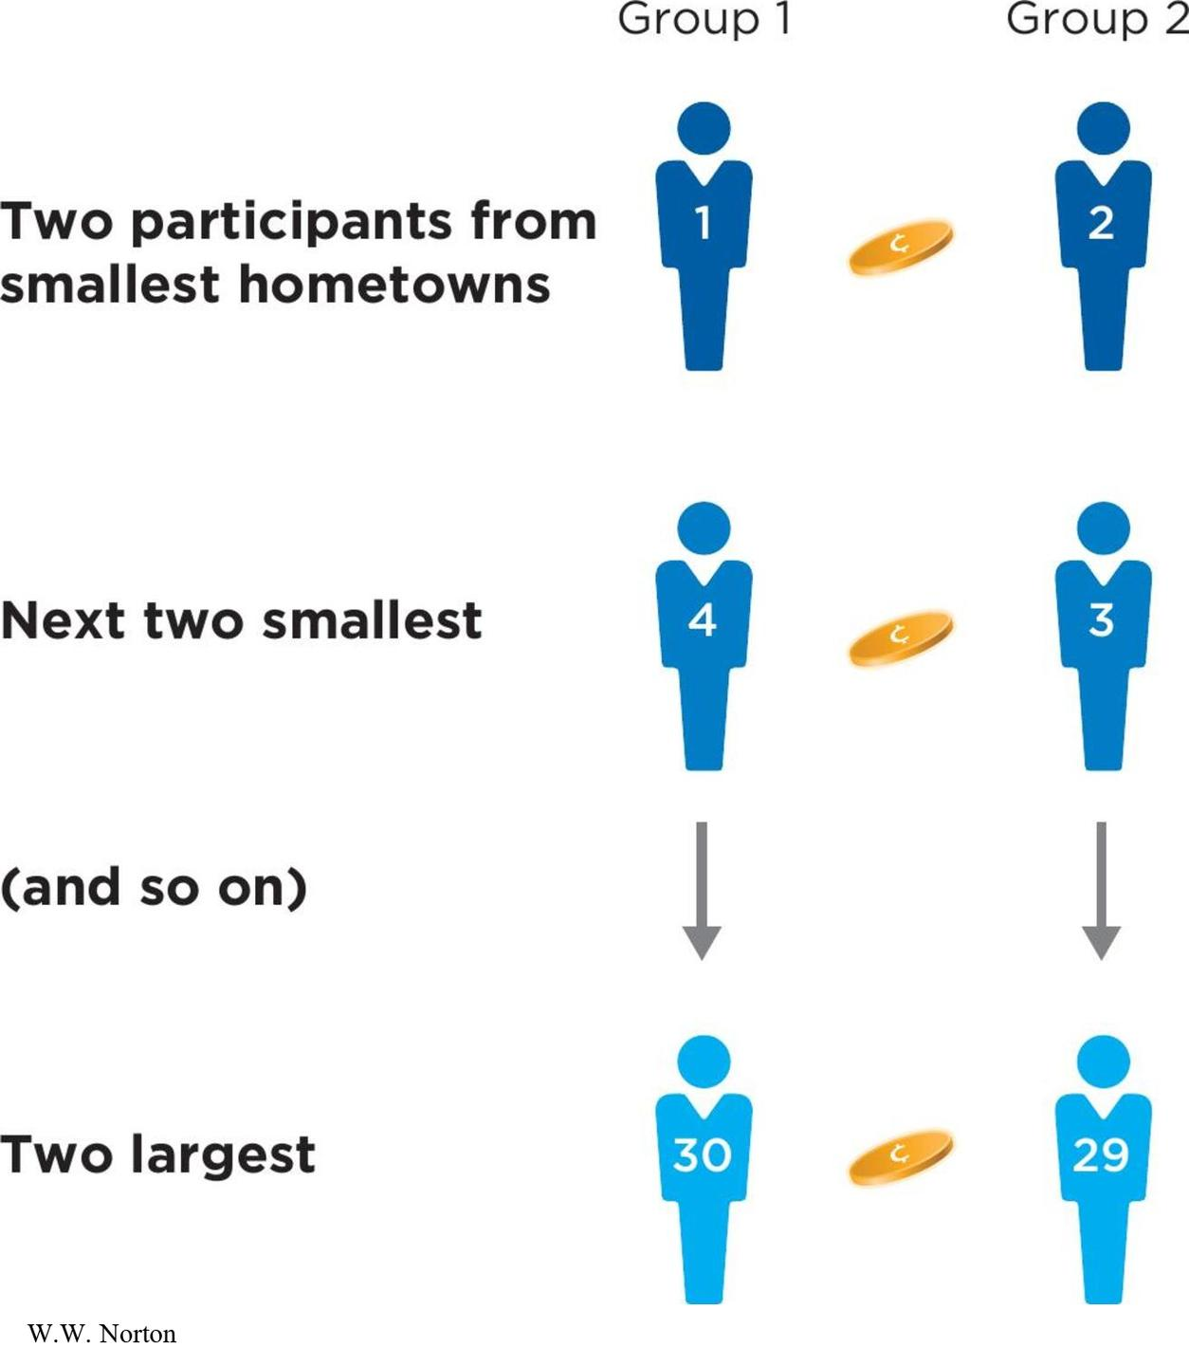
Selection Effects (2 of 2)
Avoiding selection effects with matched groups (aka matching)
Notes:
Figure 10.9 Matching groups to eliminate selection effects.
To create matched groups, participants are sorted from lowest to highest on some variable and grouped into sets of two. Individuals within each set are then assigned at random to the two experimental groups.
Random assignment doesn’t always work well if your sample size is small, as groups may be imbalanced. Some researchers prefer to use matched groups with small samples. Matching involves matching groups on some variable (e.g., student background). We randomly assign the three participants with the smallest hometowns to the three groups, then assign the next three highest participants, and so on.

Slide 14
Independent-Groups Designs
Independent-groups versus within-groups designs
Posttest-only design
Pretest/posttest design
Which design is better?
Notes:
This slide presents the section headings.
There are many forms of experiments, and the most basic distinction is between independent-groups designs and within-groups designs.

Slide 15
Independent-Groups Versus Within-Groups Designs
Independent-groups design: between-subjects designs or between-groups designs
Within-groups design: within-subjects designs
Notes:
Independent-groups design: different groups of participants placed at different levels of the IV; example: each participant was randomly assigned to either the large or medium serving bowl condition. There are two types: posttest-only and pretest/posttest.
Within-groups design: each participant is presented with all levels of the IV; example: a poster study in which each participant viewed both norms poster and flu poster.

Slide 16
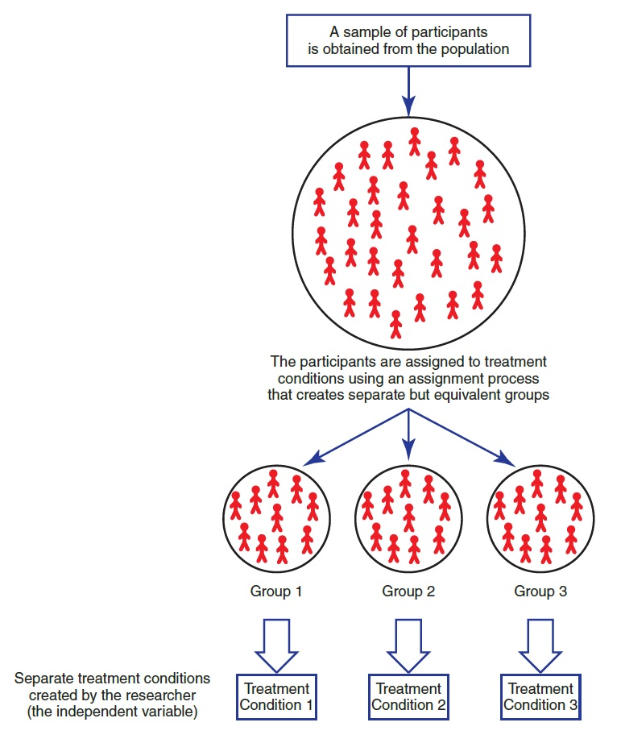
Notes:
There are some really important considerations when making our groups.
Random selection
Control for same confounds
Only thing that should differ is the manipulation

Slide 17
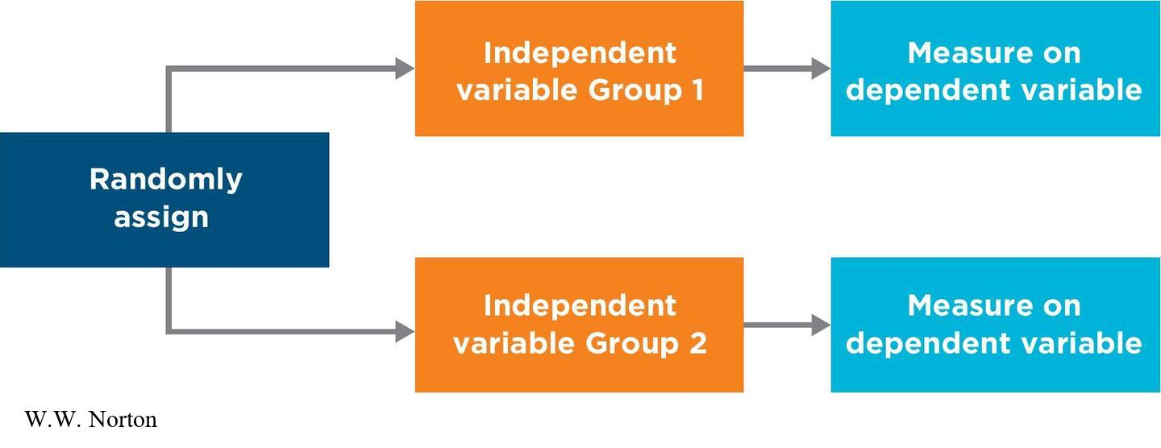
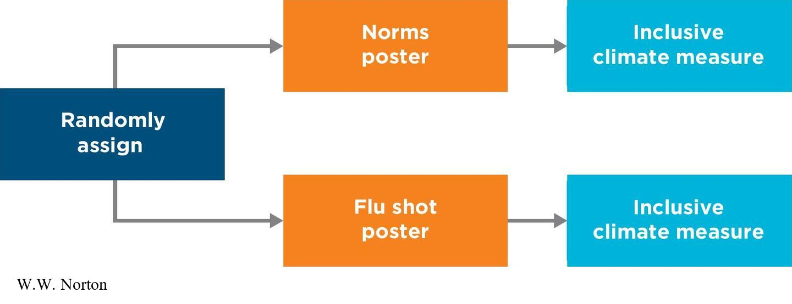
Posttest-Only Design
Posttest-only design: subjects only tested after the intervention or treatment
Notes:
Figure 10.10 A posttest-only design.
W.W. Norton
Figure 10.11 Studying norms: a posttest-only design.
W.W. Norton

Slide 18
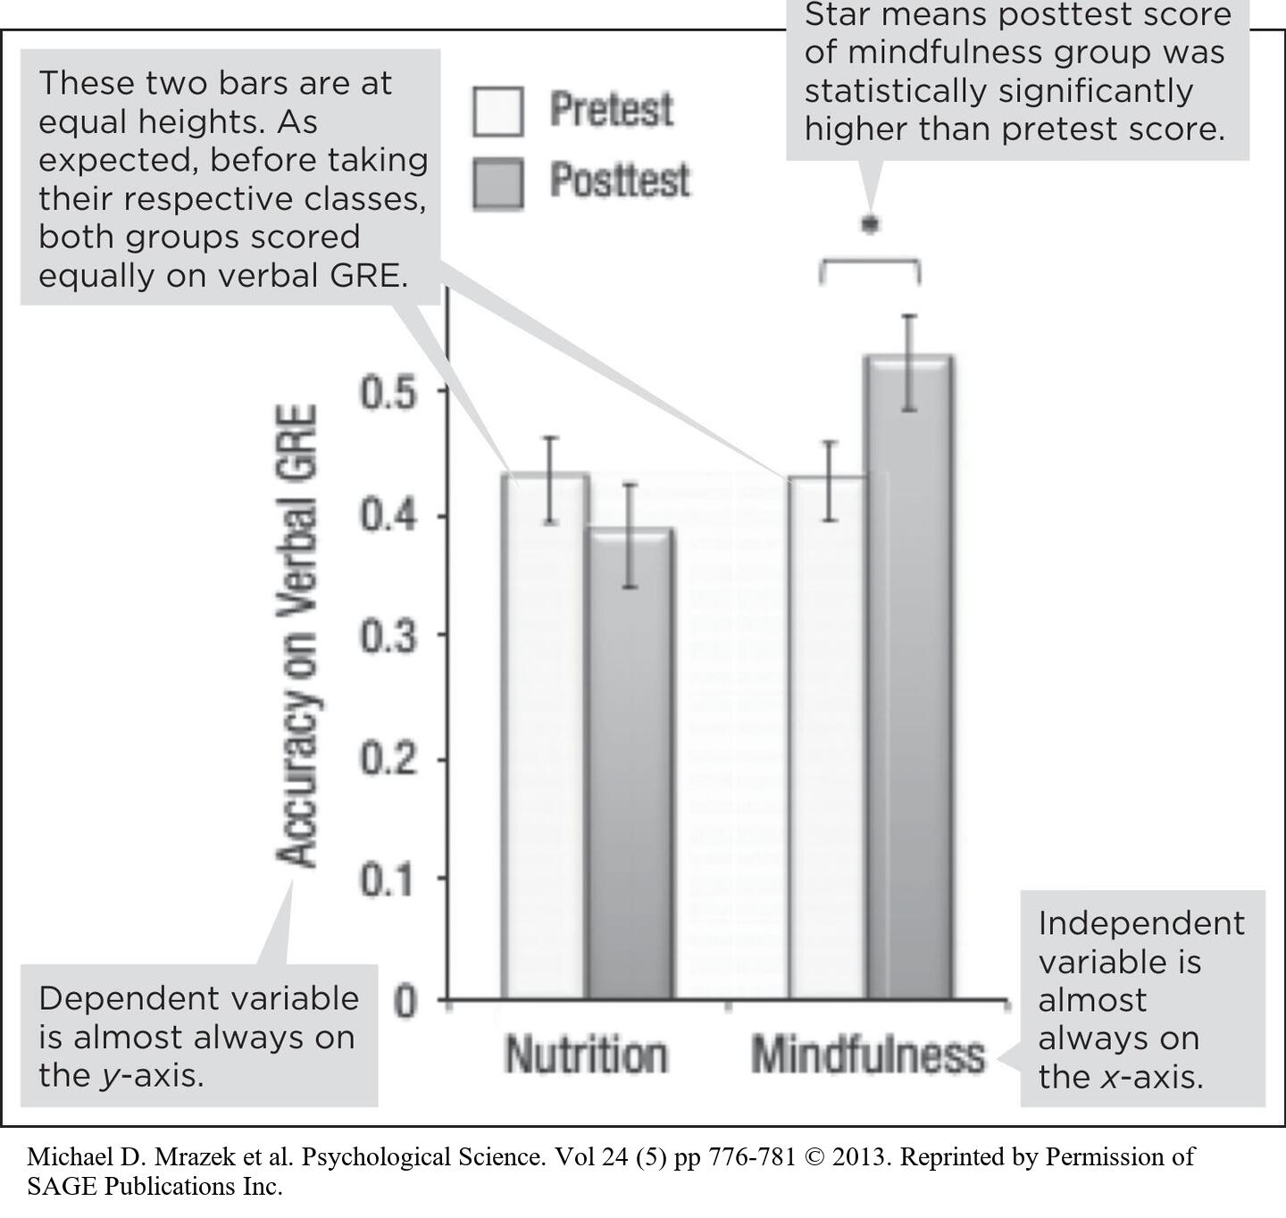
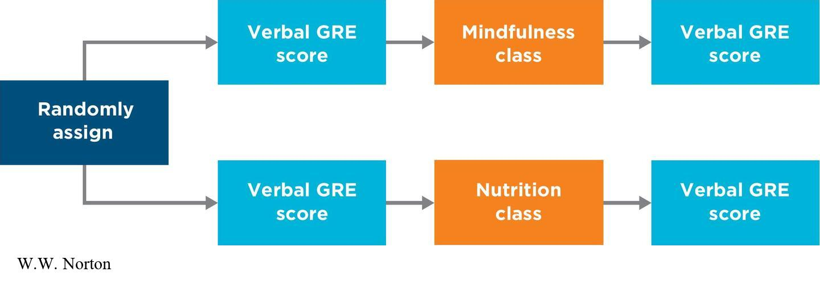
Pretest/Posttest Design
Pretest/posttest design: subjects tested once before and once after exposure to the independent variable
Notes:
Figure 10.12 A pretest/posttest design.
W.W. Norton
Figure 10.13 Results using a pretest/posttest design.
In this study, mindfulness training caused students to improve their GRE verbal scores. (Source: Mrazek et al., 2013, Fig. 1A.)
Michael D. Mrazek et al. Psychological Science. Vol 24 (5) pp 776-781 © 2013. Reprinted by Permission of SAGE Publications Inc.
In a pretest/posttest design, or an equivalent groups, pretest/posttest design, participants are randomly assigned to at least two different groups and are tested on the key dependent variable twice—once before and once after exposure to the independent variable.
Example: A study on the effects of mindfulness training, introduced in Chapter 1, is an example of a pretest/posttest design. In this study, 48 students were randomly assigned to participate in either a 2-week mindfulness class or a 2-week nutrition class (Mrazek, Franklin, Phillips, Baird, & Schooler, 2013).
One week before starting their respective classes, all students completed a verbal-reasoning section of a Graduate Record Examinations (GRE) test. One week after their classes ended, all students completed another verbal-reasoning GRE test of the same difficulty.
Figure 10.12 shows that, while the nutrition group did not improve significantly from pretest to posttest, the mindfulness group scored significantly higher at posttest than at pretest.

Slide 19
Which Design Is Better?
The research situation determines which design is better.
In some situations, it is problematic to use a pretest/posttest design.
In other situations, it makes sense to use a pretest/posttest design.
Posttest-only designs can nonetheless be very powerful.
Notes:
Deciding which design is better depends on the researcher’s particular goal.
In some situations, it is problematic to use a pretest/posttest design; example: If the DV involves eating or physical exertion, participants might become full or exhausted by having a pretest and a posttest.
In other situations, a pretest/posttest design makes sense; example: Mrazek’s and colleagues’ (2013) study.
Posttest-only designs can still be very powerful, given their combination of random assignment and a manipulated variable (IV). But if you want to make sure that the groups are equivalent at the start, you’ll need a pretest.

Slide 20
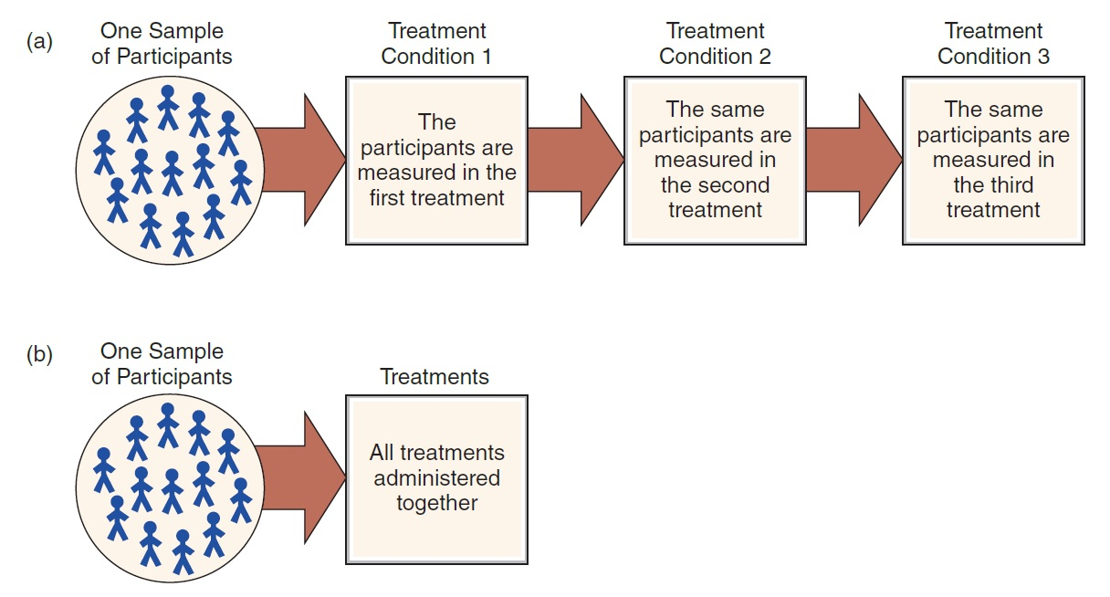
The Structure of a Within-Subjects Design
Notes:
Figure 9.1 The Structure of a Within-Subjects Design
The same group of individuals participates in all of the treatment conditions. Because each participant is measured in each treatment, this design is sometimes called a repeated-measures design. Note: All participants go through the entire series of treatments but not necessarily in the same order.

Slide 21
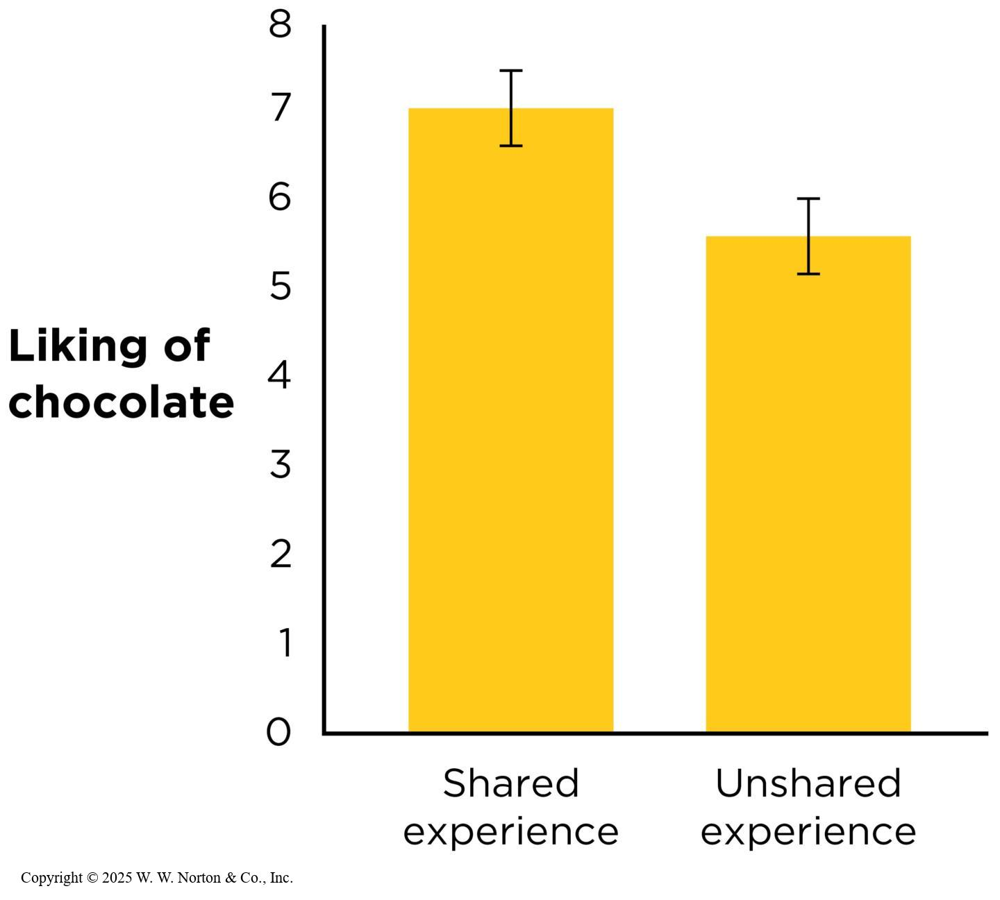
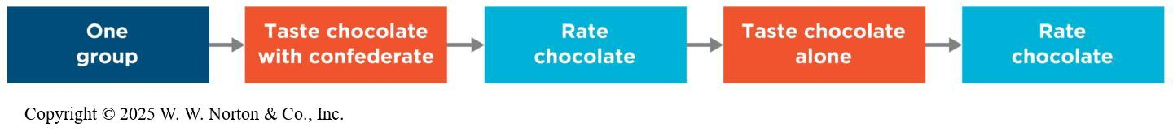
Repeated-Measures Design
Repeated-measures design: subjects measured more than once
Notes:
Figure 10.14 Testing the effect of sharing an experience using a repeated-measures design.
(A) The design of the study. (B) The results of the study. Error bars represent 95% CIs. (Source: Adapted from Boothby et al., 2014.)
W.W. Norton
A repeated-measures design is a type of within-groups design in which participants are measured on the DV more than once (after exposure to each level of the IV).
Researchers Erica Boothby and her colleagues used a repeated-measures design to investigate whether a shared experience would be intensified even when people do not interact with the other person (Boothby, Clark, & Bargh, 2014).
They recruited 23 college women to a laboratory. Each participant was joined by a female confederate. The two sat side-by-side, facing forward, and never spoke to each other. The participant was told that the two chocolates were different, but in fact, they were exactly the same. After tasting each chocolate, participants rated how much they liked it. The results showed that people liked the chocolate more when the confederate was also tasting it (Figure 10.14).

Slide 22
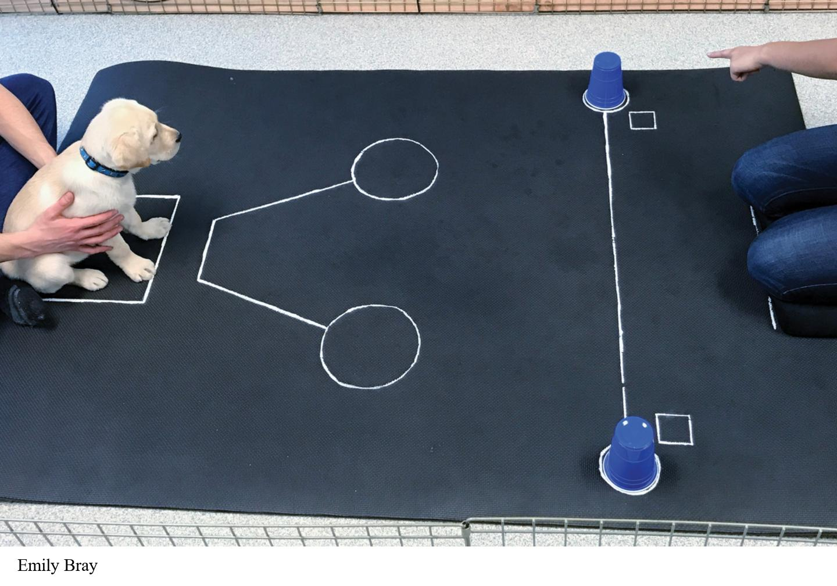
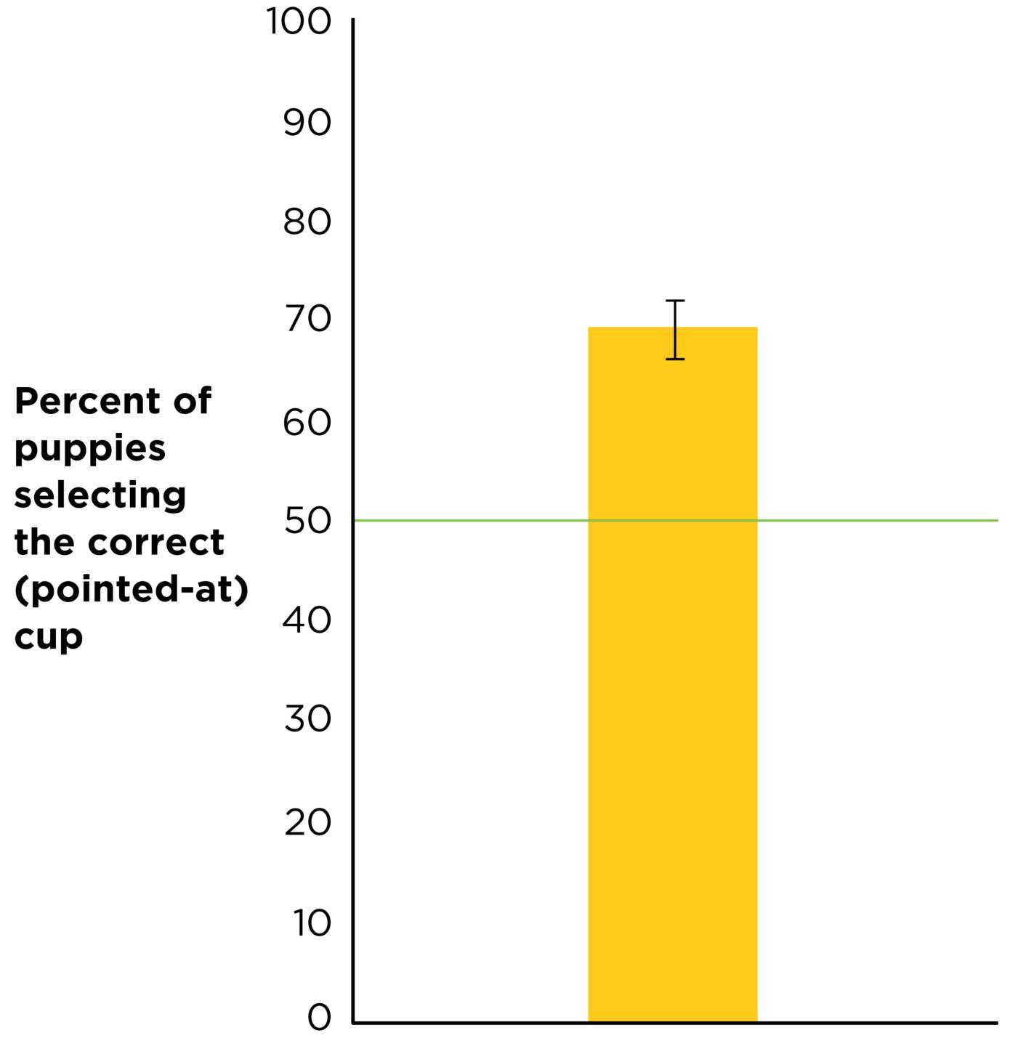
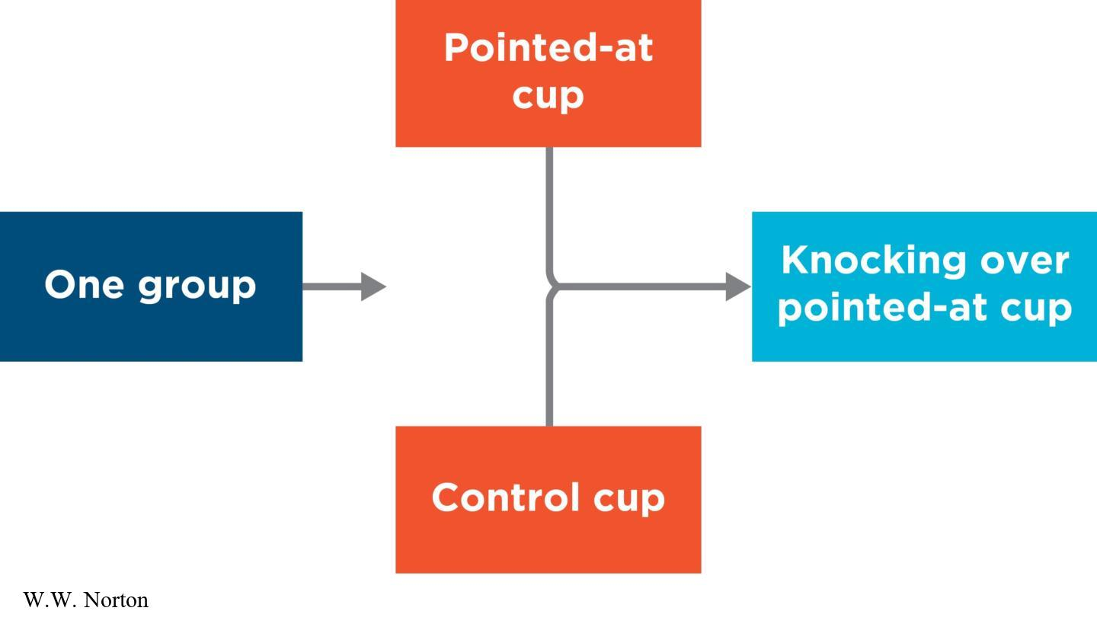
Concurrent-Measures Design
Concurrent-measures designs: subjects exposed at different levels of the IV at the same time
Notes:
Figure 10.15 A concurrent-measures design for a puppy cognition study.
(A) The design of the study. (B) A puppy in the study going to the “correct” (pointed-at) cup with the treat hidden under it. The study showed that puppies used the researcher’s pointing cue to find the treat most (69%) of the time. (C) The results of the study.
Concurrent-measures designs: participants are exposed to all levels of the IV at roughly the same time, and a single preference is the DV. The example on slide is about looking preference in infant research.

Slide 23
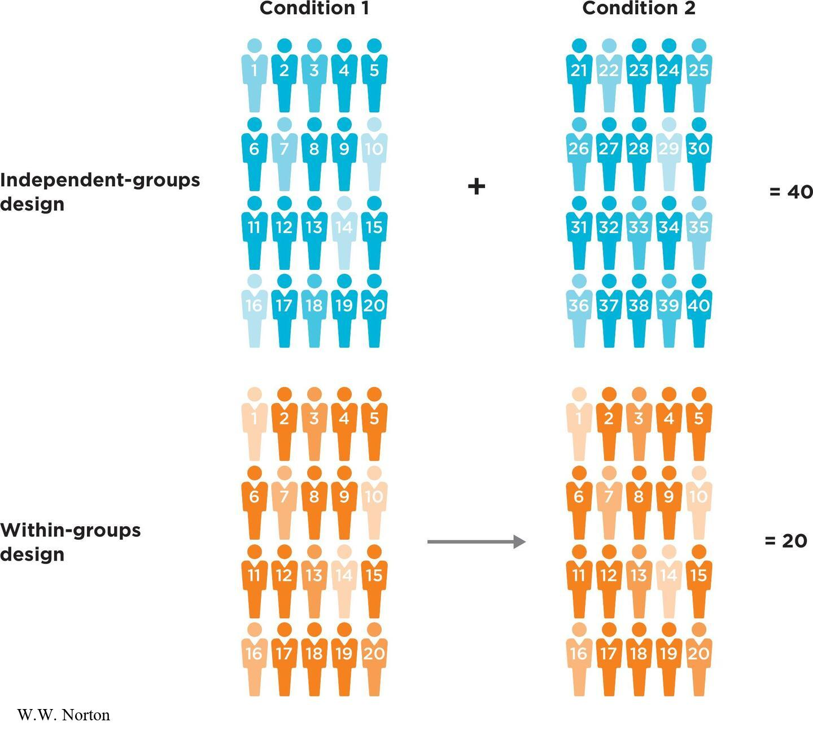
Advantages of Within-Groups Designs
Participants in your groups are equivalent because they are the same participants and serve as their own controls.
Within-groups designs require fewer participants than other designs.
Notes:
Figure 10.16 Within-groups designs require fewer participants.
If researchers want a certain number of participants in each of two experimental conditions, a within-groups design is more efficient than an independent-groups design. Although only 40 participants are shown here (for reasons of space), psychologists usually need to use larger samples than this in their studies.
W.W. Norton
For example, some people really like dark chocolate, and others do not. But in a repeated-measures design, people bring their same level of affection for chocolate to both conditions, so their individual liking for the chocolate stays the same. The only difference between the two conditions will be attributable to the independent variable (whether people were sharing the experience with the confederate or not).
If they want 20 participants in each condition, they will need a total of 40 people for an independent-groups design. However, if they run the same study as a within-groups design, they will need only 20 participants, because each participant experiences all levels of the independent variable (Figure 10.16).

Slide 24
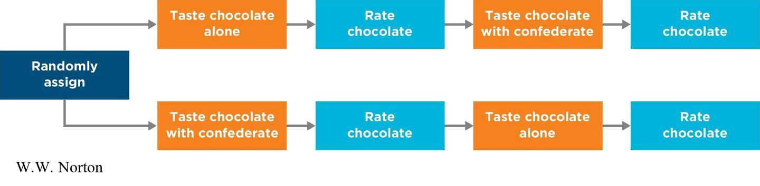
Covariance, Temporal Precedence, and Internal Validity in Within-Groups Designs
Order effects
Avoiding order effects by counterbalancing
Notes:
Figure 10.17 Counterbalanced design.
Using counterbalancing in an experiment will cancel out any order effects in a repeated-measures design.
W.W. Norton
Do within-groups designs fulfill the three causal criteria?
Covariance: There is a manipulated IV and comparison conditions.
Temporal precedence: The IV occurs before the DV.
Internal validity: Are there third-variable explanations?

Slide 25
Internal Validity: Controlling for Order Effects
When being exposed to one condition affects how participants respond to other conditions
Practice effects
Carryover effects
Notes:
Order effects have the potential to threaten internal validity. An order effect occurs when exposure to one level of the IV influences reactions to other levels of the IV. Order effects are confounds for within-groups designs because it might not be the levels of the IV that caused changes in the DV but rather the order in which the conditions were experienced.
One type of order effect is a practice effect, which occurs when participants either get better at a task from practice or get worse at a task due to fatigue (also known as a fatigue effect).
Another type of order effect is a carryover effect. This occurs when there is contamination carrying over from one condition to the next. Example: when you brush your teeth and then drink orange juice, the (unpleasant) taste of the orange juice is a carryover effect of brushing your teeth.

Slide 26
Avoiding Order Effects by Counterbalancing
Two types of counterbalancing
Full counterbalancing
Partial counterbalancing (example: Latin square)
Notes:
Figure 10.17 Counterbalanced design.
Using counterbalancing in an experiment will cancel out any order effects in a repeated-measures design.
W.W. Norton
In order to avoid order effects, researchers use counterbalancing (presenting levels of the IV to participants in different orders).
There are two types of counterbalancing: full and partial.
Full counterbalancing occurs when all possible condition orders are presented; example: with two conditions, there are two orders; with three conditions, there are six orders. The example in the figure illustrates full counterbalancing.
Partial counterbalancing occurs when only some of the possible condition orders are used; example: a researcher could present a randomized order for each participant or a Latin square (in which each condition appears in each position at least once).

Slide 27
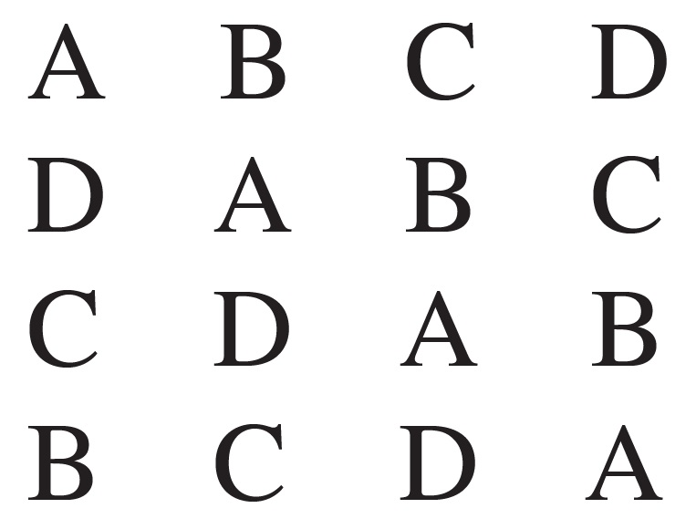
Latin Square
A Latin square can be constructed to decide which sequences to select.

Slide 28
Disadvantages of Within-Groups Designs
Potential for order effects
  Solution: counterbalancing
Might not be practical or possible
Experiencing all levels of the independent variable (IV) changes the way participants act (demand characteristics)
Notes:
Table 10.1: Two Independent-Groups Designs and Two Within-Groups Designs
Three main disadvantages of within-groups designs:
Repeated-measures designs can have order effects, but those can be controlled for using counterbalancing.
Within-groups designs are sometimes not practical or possible; example: Suppose someone has devised a new way of teaching children how to ride a bike, called Method A. She wants to compare Method A with the older method, Method B. Obviously, she cannot teach a group of children to ride a bike with Method A and then return them to baseline and teach them again with Method B. Once taught, the children are permanently changed. In such a case, a within-groups design, with or without counterbalancing, would make no sense.
Demand characteristics (aka experimental demand) occur when participants pick up on cues that lead them to guess the experiment’s hypothesis.

Slide 29
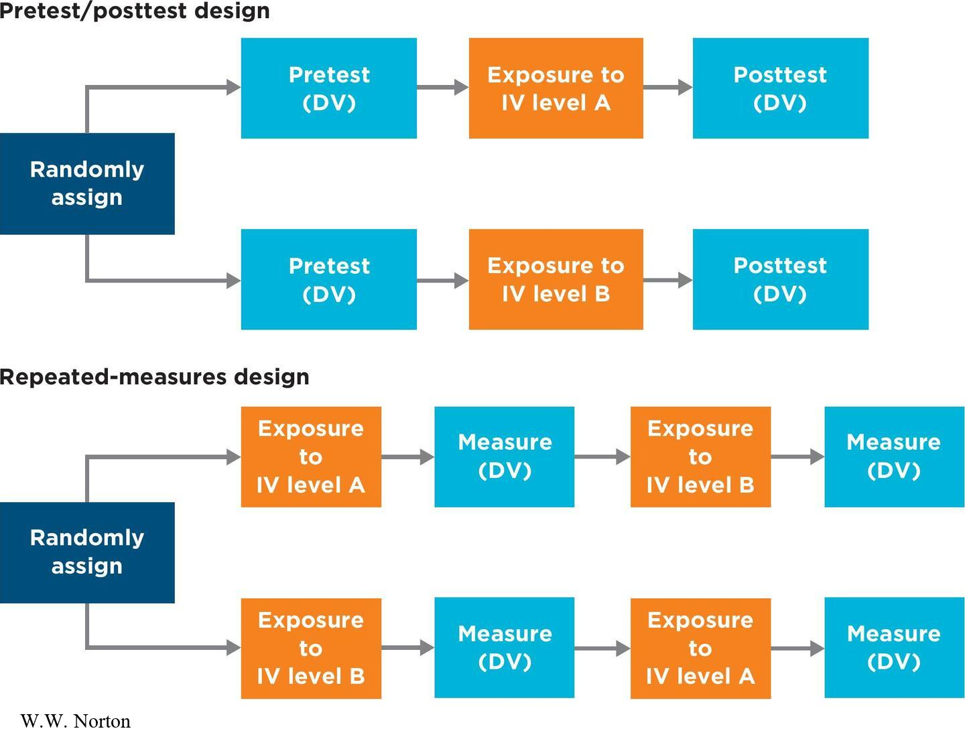
Is Pretest/Posttest a Repeated-Measures Design?
Should a pretest/posttest independent-groups design be considered a within-groups design because participants are tested twice (once at pretest and once at posttest)?
Notes:
Figure 10.18 Pretest/posttest design versus repeated-measures design.
In a pretest/posttest design, participants see only one level of the independent variable, but in a repeated-measures design, they see all the levels (DV = dependent variable; IV = independent variable).
W.W. Norton
It’s important to remember that in a true within-groups design, participants are exposed to all levels of the IV, and the levels can be counterbalanced. But in a pretest/posttest design, participants experience only one level of the IV (not all levels).
The figure shows a summary of the four types of experimental designs covered in this chapter.

Slide 30
Construct Validity:
How Well Were the Variables Measured and Manipulated?
Dependent variables: How well were they measured?
Independent variables: How well were they manipulated?
  Manipulation checks
  Pilot studies
Notes:
DV: To interrogate construct validity in the poster study, you would start by asking how well the researchers measured their dependent variable: inclusive climate ratings. Murrar’s team combined several self-report scales about attitudes and perceptions to create their inclusive climate measure. Many of these scales had been developed by previous researchers, who collected data on the scale’s reliability and validity. For example, one scale they used was the Internal Motivation to Respond Without Prejudice Scale (IMS), which measures how much people internally value being nonprejudiced. Previous research has shown that the IMS has good internal reliability, convergent validity, discriminant validity, and criterion validity, making it a construct-valid way to measure attitudes about diversity. Therefore, the inclusive climate measure in Murrar et al.'s study seems to be a well-validated way to assess people’s attitudes towards diversity and inclusion.
IV: To interrogate the construct validity of the independent variable, you would ask how well the researchers manipulated (or operationalized) it. In the Murrar study, this involved exposing participants to either a norms poster promoting diversity or a neutral poster about flu shots.
This operationalization clearly manipulated the intended independent variable, which was exposure to a pro-diversity norm.
A manipulation check is an extra dependent variable that researchers can insert into an experiment to convince them that their experimental manipulation worked. A manipulation check was not necessary in the poster study, as the researchers directly measured the impact of the poster on participants' inclusive climate ratings through a survey.
A pilot study is a simple study, using a separate group of participants, that is completed either before or, sometimes, after conducting the study of primary interest. Researchers may use pilot study data to confirm the effectiveness of their manipulations before using them in a target study.
Although manipulation checks and pilot studies aren’t always needed, they are often used by careful researchers.

Slide 31
Manipulation Checks
Directly measure whether the IV had the intended effect on the participant
Ways to check the manipulation:
  Explicitly measure the IV
  Ask specific questions about the manipulation in a questionnaire completed by participants after the experiment

Slide 32
External Validity:
To Whom or What Can the Causal Claim Generalize?
Generalizing to other people
Generalizing to other situations
What if external validity is poor?
Notes:
Generalizing to other people: How were the participants selected for the experiment? Was random sampling used? In the Murrar et al. (2020) study, the 163 participants were a convenience sample of students from the University of Wisconsin (UW) Madison. Because they were a convenience sample, you can’t be sure if the results would generalize to all UW-Madison students, let alone to college students in general. Additionally, because the study was conducted only with college students, it’s uncertain whether the results would apply to middle school or high school students.
Generalizing to other situations: External validity also applies to the types of situations to which an experiment might generalize. The Murrar study initially used a poster displayed in a waiting room to test its effects on participants' perceptions of an inclusive climate. The researchers reported additional experiments in which they used the norms poster in undergraduate classrooms and even tested a norms video instead of a poster. All studies showed consistent results, suggesting that the effect of highlighting pro-diversity norms might generalize to various contexts within a university setting. However, the study didn’t explore whether these findings would generalize to non-academic environments or different cultural contexts.
What if external validity is poor? Remember that in an experiment, the validity that is emphasized most is internal validity (i.e., experimental control). To achieve experimental control, researchers sometimes conduct their studies in controlled laboratory environments that may not represent the real world. Many experiments sacrifice real-world representativeness in exchange for internal validity. Testing their theory and isolating the causal variable from potential confounds were the steps Murrar and her colleagues, like most experimenters, prioritized. Running an experiment on a relatively homogeneous sample (such as college students) meant that unsystematic variability was less likely to obscure the effect of the independent variable. Replicating the study using several samples in a variety of contexts is a step saved for later.

Slide 33
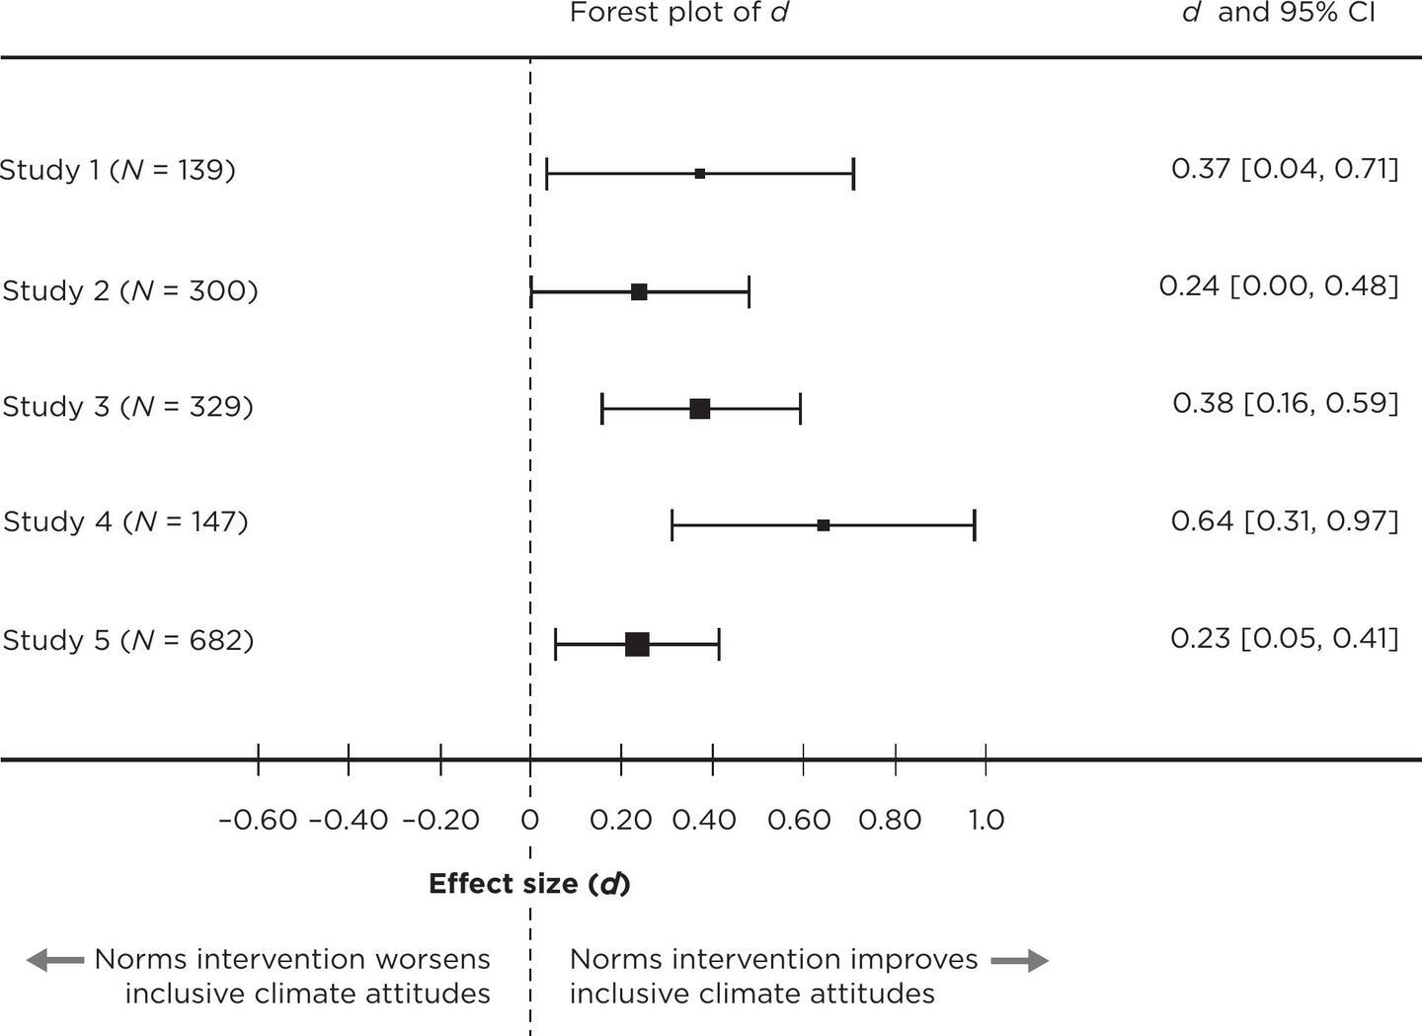
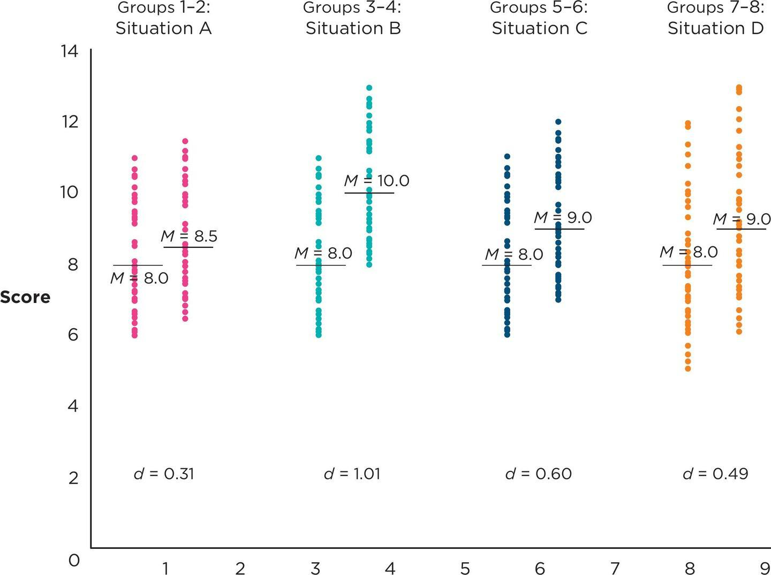
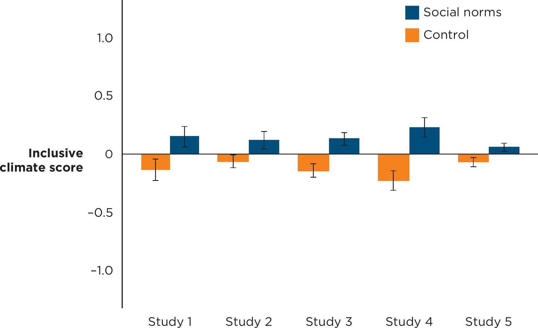
Statistical Validity:
How Much? How Precise? What Else Is Known? (1 of 2)
Effect size
Confidence intervals and statistical significance
Replication
Notes:
Figure 10.21 Effect size and overlap between groups.
Figure 10.22 Forest plot of five replications of the norms intervention study.
Figure 10.23 Bar graph of five replications of the norms intervention study.
Is the difference statistically significant? Is the difference between the means obtained in the experiment statistically significant? Are you reasonably sure that the results did not occur by chance? If your result isn’t statistically significant, then you can’t conclude that you have covariance.
Effect size: Effect size can help determine covariance. Typically, the larger the effect size, the stronger the causal effect. In experiments, researchers can express effect size in two different ways. The first is in original units, and the second is as a standardized effect. An example of original units in the Murrar et al. (2020) study might be the scores on the inclusive climate measure. The second way is to use a standardized effect size. When there are two groups, researchers often use an indicator of standardized effect size called d. This coefficient quantifies how far apart two groups are on the dependent variable. It indicates the distance between group means and how much scores within groups overlap. A large d suggests a strong relationship between the independent variable (IV) and the dependent variable (DV), while a small d indicates a lot of overlap in your groups. See Figure 10.21, which illustrates that while the difference between means is exactly the same in two graphs, the effect sizes differ due to the spread of the scores (i.e., the amount of overlap). Which method is better depends on your goal: original units are good for estimating the real-world impact, while standardized effect sizes are useful for comparing effects based on different units.
Confidence intervals and statistical significance: How precise is the estimate? A 95% confidence interval (CI) reflects precision: a smaller n with more variability will have a wider CI, indicating less precision. We can calculate CIs for both original units and d. The 95% CI for the Murrar et al. study would reflect the range of possible true population differences, providing insight into the certainty of the observed effect.
Replication: Another important step in estimating the population effect is to conduct the study multiple times to find multiple estimates. For example, if another researcher repeated the norms poster study with a different group of students, consistent results would strengthen the confidence in the effect observed by Murrar et al. (2020). Murrar's study was supported by additional experiments using different contexts (e.g., classrooms, video interventions), all of which found similar effects. When studies are replicated, their estimates can be combined to provide an even better estimate of the true population value through meta-analysis.

Slide 34
Internal Validity:
Are There Alternative Explanations for the Results?
Three fundamental questions about internal validity:
  Were there any design confounds?
  If an independent-groups design was used, did researchers control for selection effects using random assignment or matching?
  If a within-groups design was used, did researchers control for order effects by counterbalancing?
Notes:
Remember that internal validity is the top priority when interrogating a causal claim.
Did the experimental design ensure that there were no design confounds, or did some other variable accidentally covary along with the intended independent variable? (Murrar et al. [2020] ensured that the experimental conditions were controlled by placing participants in waiting rooms with either a norms poster or a flu shot poster. The design aimed to isolate the effect of the norms poster on participants' perceptions of inclusive climate.)
If the experimenters used an independent-groups design, did they control for selection effects by using random assignment or matching? (Random assignment was used in Murrar et al.’s study to control for selection effects, as participants were randomly assigned to view either the norms poster or the flu shot poster.)
If the experimenters used a within-groups design, did they control for order effects by counterbalancing?(Counterbalancing is not relevant in Murrar et al.’s design because it was an independent-groups design.)
Note: More threats to internal validity are presented in Chapter 11.

